Slide 1


Focus Web Developer
Week 1 - Lesson 5
Notes:
Welcome your class, think about what is the hook to engage your students right out of the starting gate.

Slide 2
Lesson Topics
Review
HTML 5
Unit Capstone – due end of Week 2
Notes:
Pre-test
Two-way learning

Slide 3

Skills Review
Developing Environments
Embedding JavaScript
External JavaScript
Creating HTML docs
Text Editor
JavaScript Attributes

Slide 4

Skills Review
JavaScript Math
JavaScript Math Operators
JavaScript Math Operands
JavaScript Data
JavaScript Data Types

Slide 5
JavaScript Review
Programming Problem Domains
ECMA Script
JavaScript’s Role
JavaScript’s Pre-eminence

Slide 6

HTML 5
HTML stands for Hyper Text Mark Up Language
Hyper Text refers to the most basic characteristic of HTML

Slide 7
HTML 5
Hyper Text is text that is hyper-linked to other content on the web
Hyper Text is clickable text that transports you to other content on the web

Slide 8
HTML 5
Mark up Language refers to the fact that HTML is a Mark-Up language
A Mark-Up Language is not a programming language

Slide 9
HTML 5
Mark-Up Languages are used to ‘’mark up” other content
Marking Up content is the used to define meaning to the content

Slide 10
HTML 5
So, HTML is a Mark-Up Language (not a programming language) that is used to “Mark-Up” our content of our Web Page

Slide 11
HTML 5
Because HTML is a Mark-Up language, we use it to give meaning to our Web Pages’ content

Slide 12
The Semantic Web
When we give meaning to content it is called Semantic
Semantic Content is Web Content that has meaning attached to it

Slide 13
The Semantic Web
The Semantic Web is the name that is applied to properly Marked-Up Content that is on the web
The Semantic Web is what is powering the evolution of the World Wide Web

Slide 14
The Semantic Web
Making sure that your Web Page is built with Semantic Web best practices makes it Future Proof
Future Proofing your Web Page is a way of ensuring that it is built to today’s best practice

Slide 15
The Semantic Web
Future Proofing your Web Pages also ensures that it will be a part of the future of the World Wide Web
Coming changes to the Web will make further use of Semantic Web Pages

Slide 16
The Semantic Web
We use HTML along with CSS and JavaScript to create modern Web Pages

Slide 17
CSS
CSS stands for Cascading Style Sheets

Slide 18
CSS
CSS is the Web Technology that we use to create the Presentation layer of Web Pages

Slide 19
CSS
HTML creates the Semantic Structure of our Web Pages
We use CSS to create the look and feel of our Web Pages

Slide 20
CSS
Best practice Web Development requires you to keep the Structure of your Web Pages totally separate from your Presentation of your Web Pages

Slide 21
CSS
We never use HTML to define the look or feel of our Web Pages
HTML is strictly for creating Semantic Structure

Slide 22
CSS
CSS is strictly for creating the presentation of our Web Pages
We use CSS by creating CSS rules

Slide 23
CSS
CSS Rules define the look of the Web Page

Slide 24
CSS
Browsers do have some default CSS rules
These CSS rules will make your HTML applied content look a certain way

Slide 25
CSS
We can over-ride these built-in CSS rules, but they do provide us a good starting point

Slide 26
CSS
Just like JavaScript, we can create separate CSS files

Slide 27
Activity 1
Create a new folder
Name the folder firstname_lastname_1_5_1
Open up Brackets and open this working folder
Create an HTML file in this folder and name it index.html
Create an external JavaScript file and name it scripts.js
Create an external CSS file and name it styles.css
HTML Creation

Slide 28
<!DOCTYPE html>
<html>
<head>
<title>My Second JavaScript Page</title>
<meta charset=“UTF-8” >
<link rel=”stylesheet” href=”styles.css”>
</head>
<body>
</body>
</html>
HTML Creation

Slide 29
<h1>Week 1 Day 5 Web Page</h1>
<p>Today is the Jan 1, 2020</p>
<p>Today we have learned about the <strong>Semantic</strong> web. The <strong>Semantic</strong> web is <em>future proofing</em> the World Wide Web. The <a href=”https://www.w3.org/”>WWWC</a> is the organisation that puts out all the recommendations of how the Web is going to be improved, and is the body that most professional Web Developers follow in order to create Web Pages and Web Apps that are built with best practices.</p>
HTML Creation
Inside the body tags

Slide 30
<p>This week we’ve covered a lot of ground. We’ve learned about: <ul><li>HTML</li>CSS<li></li>JavaScript<li></li>JavaScript’s use in building interactivity and functionality<li>JavaScript’s importance and adoption</li>JavaScript Developing Environments<li>JavaScript Operational Environments</li>Text Editors<li>and a lot more</li></ul> We’ve also learned how the three main Web Technologies: <ul><li>HTML</li><li>CSS</li><li>JS</li></ul> are the fundamental building blocks of Web Pages and Web Apps.</p>
HTML Creation
Inside the body tags

Slide 31
h1{
color: red;
}
p{
font-size: 16px;
}
HTML Creation
Create the CSS file

Slide 32
alert(“Hello Web Developers of the world!”);
HTML Creation
Create the JS file

Slide 33
Activity 2
Attach the JS file.
Test your index.html file in a browser
HTML Creation
Attach the JS file

Slide 34

Discussion
Let’s break into groups
Share your code
Debug each other’s code
Share Code

Slide 35
Unit 1 Project
Project Overview and Guidelines

Slide 36
Unit 1 Project Overview
Create your first Web App
Pick a topic for your Web App
Something that interests you
Something that involves Tech and/or Indigenous concepts
Submit the idea to your instructor
Notes:
Upload Capstone handout for students.

Slide 37
Topic Ideas
“The Digital Divide” and First Nations Communities
Language and culture
Economic development
Health and wellness
Education and digital skills
Social media and Community
Art and digital innovation
Come up with your own!

Slide 38
Unit 1 Project Overview
Your Web App will include:
A main HTML page
2 external HTML pages
1 external JS file
1 external CSS file

Slide 39
Unit 1 Project Overview
Your Web App will include:
At least 3 paragraphs of text on the main HTML page
At least 2 paragraphs of text on each additional HTML page
At least 1 image per HTML page
1 JavaScript-driven action

Slide 40
Guidelines and Grading
Submission is to include a main parent folder, with sub-folders for JS and CSS
Name the main folder: firstname_lastname_Unit1_capstone
Grading breakdown: 30% for content, 30% for visuals and 40% JavaScript interaction for a total of 20% of your final grade
Be creative and have fun!

Slide 41
Unit 1 Project
Let’s get started!

Slide 42
Gathering Time
Gathering Time is a time for check-in.
Notes:
Instructors Notes:
Introduce the concept of Gathering Time, which will be used throughout the program.
The sharing stone can be just a stone someone in the class wants to use or one from outside.
It just reminds everyone to listen when the person with the stone talks, so everyone has an opportunity to listen.
Chairs only
Someone from the host Nation can be offered to start the check-in first. If no one is interested then someone else in the group, or the Instructor, will be offered to start it next.

Slide 43
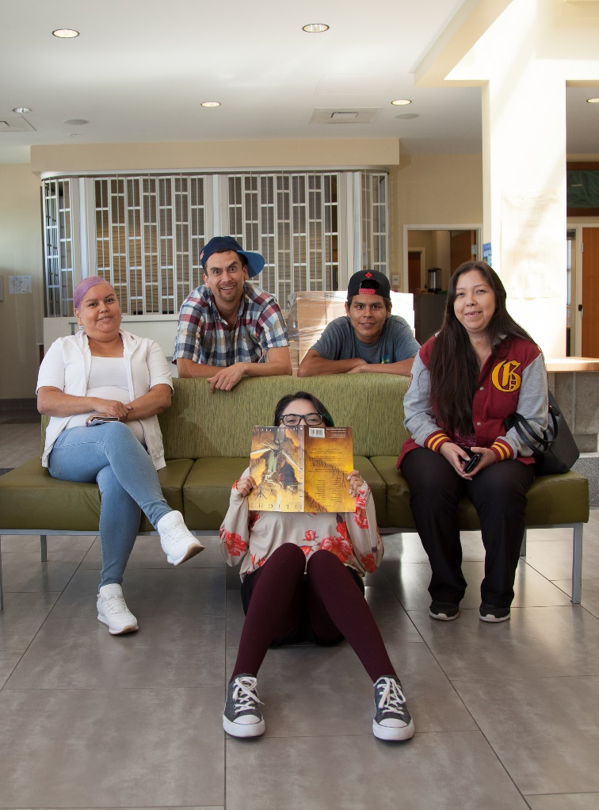
Class Wrap-up
How was your day?
How’s your website coming along?
Are you excited to add some colour?
Notes:
Post test: provide the students with feedback about the day, review the day.
End of the day Q/A
Were the day’s goals met (reference slide 2)?
Transition: what’s coming up tomorrow?

Slide 44
Image Credits
Unless specified, all images in this slide show are from the following sources
Unsplash via the Unsplash License
Pexels and Pixabay via the CC0 License or the Pexels License
Wikimedia Commons
First Nations Technology Council and its partners
Pow wow https://www.cbc.ca/kidscbc2/the-feed/do-you-know-what-a-powwow-is
Colors http://precisionintermedia.com/color
Fonts https://furbo.org/2018/03/28/system-fonts-in-css/

